Slide 1
APPLICATIONS OF LLM IN NLP
CCDS - NTU
DEC 2024
NATURAL
LANGUAGE
PROCESSING
WORD2VEC ◉ SKIPGRAM ◉ TRANSFORMERS

Slide 2


What’s a Word?
Introduction
Smallest meaningful unit in language

Slide 3
What’s a Word?
Introduction
Smallest meaningful unit in language
Need a way to store them. What about dictionaries?

Slide 4
What’s a Word?
Introduction
Smallest meaningful unit in language
Need a way to store them. What about dictionaries?
Not Static
Lack of Context

Slide 5
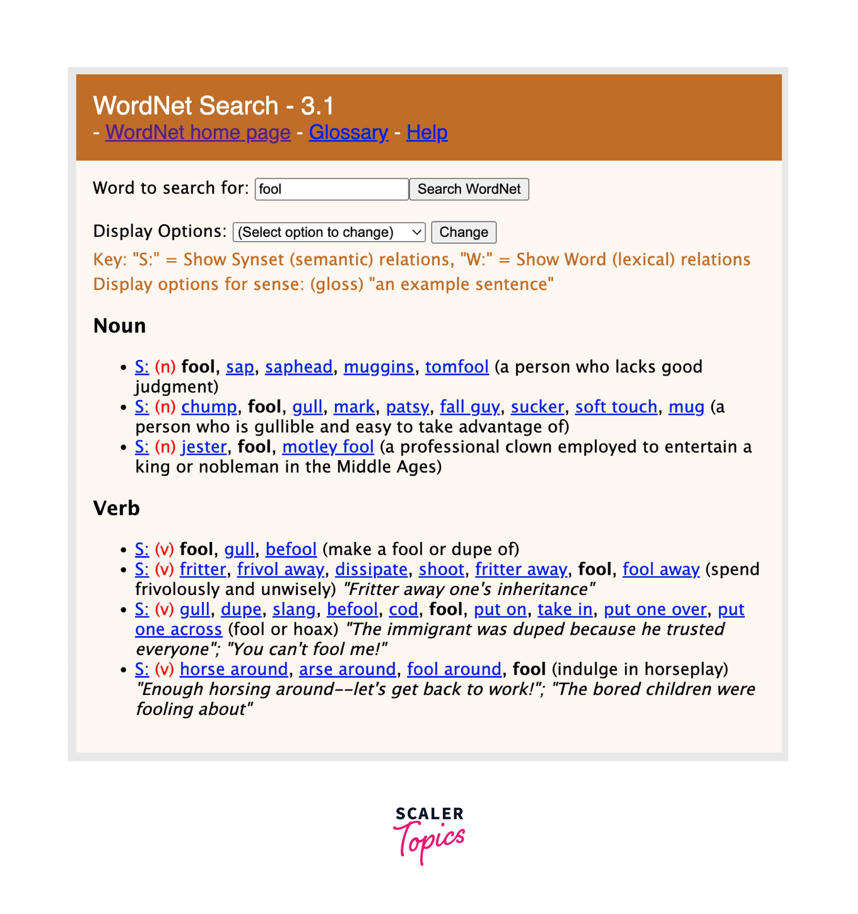
WordNet
Lexical Database
Connects words based on their meanings

Slide 6
WordNet
Lexical Database
Connects words based on their meanings
Limitations
Frequency of Updates
No Context

Slide 7
One Hot Encoding
Convert Categories into Binary
A popular approach in Discrete Word Representations, where each word in a vocabulary is represented by a vector with one ‘1’ corresponding to that word and all other positions set to ‘0’.

Slide 8


One Hot Encoding
Convert Categories into Binary
Citizenship Status
SGC
Citizenship Status - Exact Values
SGPR
SGC
SGPR
INTL
001
010
SGPR
INTL
SGC
100
SGPR

Slide 9
One Hot Encoding
Convert Categories into Binary
Citizenship Status
Citizenship Status (Binary)
SGC
0
0
1
SGPR
0
1
0
INTL
1
0
0
SGPR
0
1
0
SGC
0
0
1
SGPR
0
1
0

Slide 10
One Hot Encoding
Convert Categories into Binary
A popular approach in Discrete Word Representations, where each word in a vocabulary is represented by a vector with one ‘1’ corresponding to that word and all other positions set to ‘0’.
Citizenship Status - Exact Values
SGC
SGPR
001
010
INTL
100
While simple, it cannot capture relationships between different words. SGC is as unrelated to SGPR as Superman is to Watermelon.

Slide 11



One Hot Encoding
Convert Categories into Binary
Citizenship Status - Exact Values
SGC
SGPR
Similarity Metric : Cosine Similarity
001
010
INTL
100
One Hot Encoding gives Orthogonal* Vectors
Thus, Similarity is always 0.
Vector Dot Product
Sum of products of corresponding entities of 2 vectors.
(2i + 3j) · (10i+1j) = 20i + 3j
*Perpendicular Vectors

Slide 12
One Hot Encoding
3
32
4
33
2
31
5
34
1
6
7
30
35
36
8
38
37
41
9
10
40
13
39
11
12
16
17
15
18
14
19
20
21
23
22
28
42
24
43
25
26
27
44
62
45
63
50
46
47
65
48
66
51
49
68
67
64
52
53
54
69
57
58
55
56
70
59
71
60
61

Slide 13
What if the distances had meanings?
3
32
4
33
2
31
5
34
1
6
7
30
35
36
8
38
37
41
9
10
40
13
39
11
12
16
17
15
18
14
19
20
21
23
22
28
42
24
43
25
26
27
44
62
45
63
50
46
47
65
48
66
51
49
68
67
64
52
53
54
69
57
58
55
56
70
59
71
60
61

Slide 14
What if the distances had meanings?

Slide 15
Continuous Representation
Convert Categories into Binary
Word embeddings
Way of representing words as vectors in a multi-dimensional space, where the distance and direction between vectors reflect the similarity and relationships.

Slide 16




Continuous Representation
Convert Categories into Binary
Word embeddings
Way of representing words as vectors in a multi-dimensional space, where the distance and direction between vectors reflect the similarity and relationships.
Uses of Word Embeddings
Text
Classification
Named Entity Recognition
Machine Translation
Text
Generation
Information Retrieval
Pre-Training Models

Slide 17

Word Embeddings
Continuous Representation
Word Embeddings
Frequency Based
Prediction Based
*Perpendicular Vectors

Slide 18





Word Embeddings
Continuous Representation
Word Embeddings
Frequency Based
Prediction Based
Representation from frequency in corpus.
Eg: Term Frequency-Inverse Document Frequency (TF-IDF)
No of Times t appears in document d
Total number of terms in d
Total No of Documents in D
Number of docs containing t + 1

Slide 19
Word Embeddings
Continuous Representation
Word Embeddings
Frequency Based
Prediction Based
Representation derived from models that are trained to predict certain aspects of a word's context or neighboring words
Capture semantic relationships and contextual information
Can differentiate between synonyms and handle polysemy
They generalize well to unseen words or contexts, making them robust in handling out-of-vocabulary terms
Eg: Word2Vec and GloVe

Slide 20
WORD2VEC
Developed by a team of researchers at Google
Creation Year : 2013
Full Name : Word To Vector
Prediction Based Word Embeddings

Slide 21
WORD2VEC
Word2Vec leverages the context of words to learn meaningful vector representations.
Word2Vec has two main paradigms:
Continuous Bag of Words (CBOW): Predicts the center word based on the context words.
Skip-gram: Uses the center word to predict the surrounding context words.

Slide 22




CBOW
The CBOW model predicts a target word (𝑤𝑡) based on a set of context words (𝐶).
Mathematical Representation:
Each word is represented by a vector
Aggregation:
Embedding vectors of the words are aggregated, typically by summing.
Prediction:
Aggregated vector is passed through a neural network to predict the target word wt. The model maximizes the log-likelihood of the target word given the context.
Where m is the window size

Slide 23


SKIP-GRAM
In the Skip-gram model, the likelihood function predicts the probability of a context word given a center word. The goal is to maximize the probability of predicting the context words based on the center word:
This function helps the model adjust the word vectors, bringing similar words closer together in the vector space.
The Skip-gram model maximizes the sum of log probabilities for all context words:

Slide 24
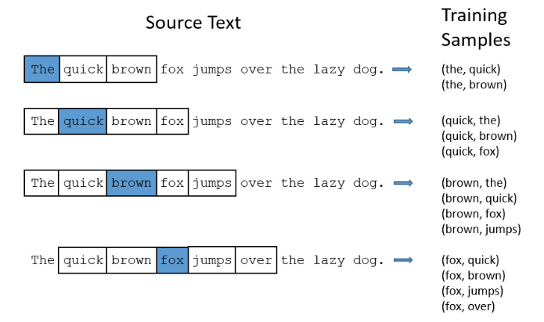
SKIP-GRAM

Slide 25
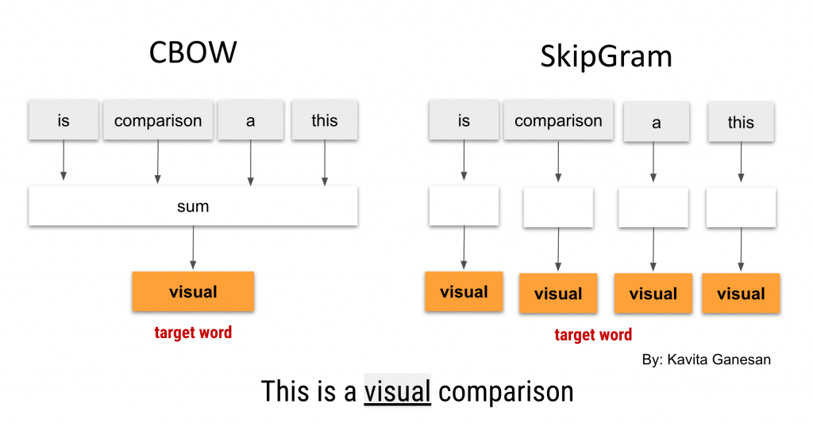
A VISUAL COMPARISON

Slide 26
LIMITATIONS
Lack of Polysemy : Word2Vec uses a fixed vector for each word, which means it cannot adapt to different meanings based on context.
Out of Vocabulary (OOV) Words : Word2Vec struggles with unseen words that weren’t part of the training corpus.

Slide 27
LIMITATIONS
Lack of Polysemy : Word2Vec uses a fixed vector for each word, which means it cannot adapt to different meanings based on context.
Out of Vocabulary (OOV) Words : Word2Vec struggles with unseen words that weren’t part of the training corpus.
OPTIMIZATION TECHNIQUES
Negative Sampling:
Instead of computing the softmax over the entire vocabulary, the model samples a few negative words (not in the context) and updates only their embeddings.
Hierarchical Softmax:
A binary tree structure is used to reduce the computational complexity of the softmax from 𝑂(|V|) to 𝑂(log|V|). Each word is a leaf node, and predicting a word involves traversing the tree.

Slide 28
TRANSFORMERS

Slide 29
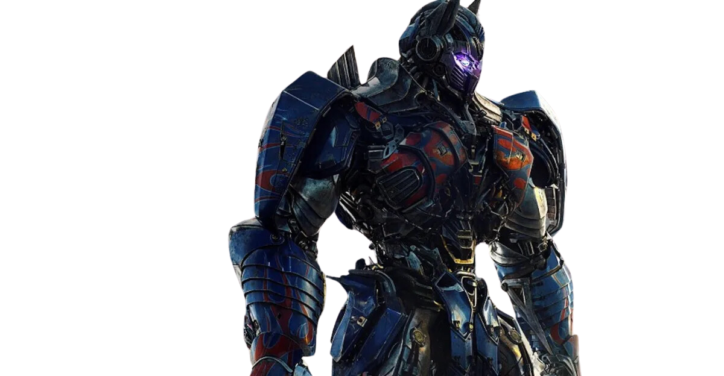
TRANSFORMERS

Slide 30

TRANSFORMERS

Slide 31
TRANSFORMERS
Transformers are a type of deep learning model introduced in the groundbreaking paper "Attention is All You Need" (Vaswani et al., 2017). They are designed to handle sequential data, such as text, by leveraging a mechanism called self-attention to capture relationships between words, regardless of their distance in the sequence.
Unlike traditional models like RNNs or LSTMs, which process data sequentially and can struggle with long-range dependencies, Transformers process all words in a sequence simultaneously, making them highly efficient and effective at capturing context.
Features include Self-Attention Mechanism & Parallel Processing.
Widely used in natural language processing (NLP) tasks like text generation, machine translation, and question answering. They are the foundation of state-of-the-art models like BERT, GPT, and T5.

Slide 32
THANK
YOU.

